Slide 1
Estimation of droplet parameters using PDIA and Machine Learning
Dual Degree Project Final Report
Unnikrishnan P V | ME17B173

Slide 2
Objective
Using a combination of image processing and Convolutional Neural Networks for droplet size measurement and determination of the position of the droplet with respect to the focal plane.

Slide 3
Introduction
Characterization of dense sprays remains one of the challenges of sprays diagnostics. Sizing of droplets has a broad range of applications such as sprays in internal combustion engines, pesticide sprays and hydroturbine aeration.
Particle/Droplet Image Analysis (PDIA) or shadowgraphy is one such method that employs direct imaging and performs well in low-pressure sprays with droplet sizes of the order of 100 µm.
Shadowgraphy employs conventional image processing for droplet sizing that can be time consuming, and the steps involved are computationally intense.
Employment on CNNs along with shadowgraphy could yield fast and accurate results in droplet characterization.

Slide 4
Project Methodology
Literature Survey
Familiarising with the toolkit
Understanding the data
Applying Computer Vision algorithms
Train CNN model for focused images
Train CNN model for defocused images
Test the real-time capabilities of model

Slide 5
Computer Vision Algorithms
The algorithm that has been used to classify the droplets can be split into two parts
Detection of circular droplets on the raw images
Classification of detected circles into the six diameter classes

Slide 6
Detection of circles: Hough Transform
The Hough Transform is a method that is used in image processing to detect any shape, if that shape can be represented in mathematical form. It can detect the shape even if it is broken or distorted a little bit.
To detect a circle in a 2-D system, three parameters need to be determined: a, b, and r.
To find possible circles, the algorithm uses a 3-D matrix called the “Accumulator Matrix” to store potential a, b and r values.
Before the actual transform is applied, image undergoes blurring, conversion to grayscale and edge detection to ensure the circles show as darkened image edges.
The circle candidates are produced by “voting” in the Hough parameter space and then selecting local maxima in the accumulator matrix.

Slide 7
Hough Transform Parameters
Parameter | Value
Detection Method | HOUGH_GRADIENT
dp | 1
minDist | rows/16
Param1 | 200
Param2 | 30
minRadius | 1
maxRadius | 200

Slide 8
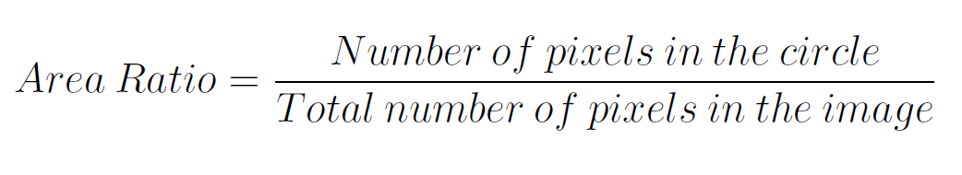
Classification of circles: Area Ratio
For droplets that are in focus, the area of the raw image occupied by the droplet is strong enough metric for classification. A metric called Area Ratio has defined for each individual circle as follows:
The ranges of Area Ratios of different diameters are reasonably disjoint. To classify the detected circles, a heuristic was defined based on a different lower and upper limit for area ratios for different diameters.

Slide 9
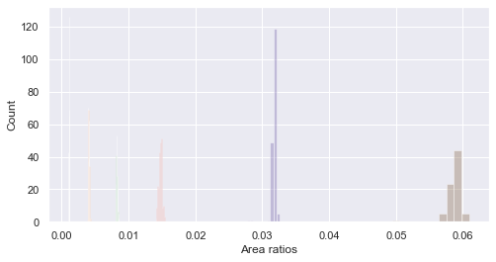
Distribution of Area Ratios for different diameters

Slide 10
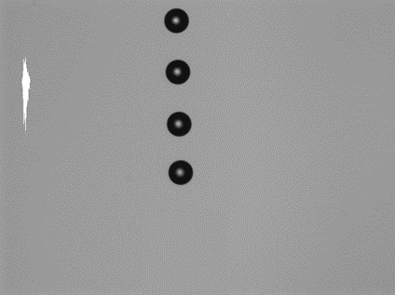
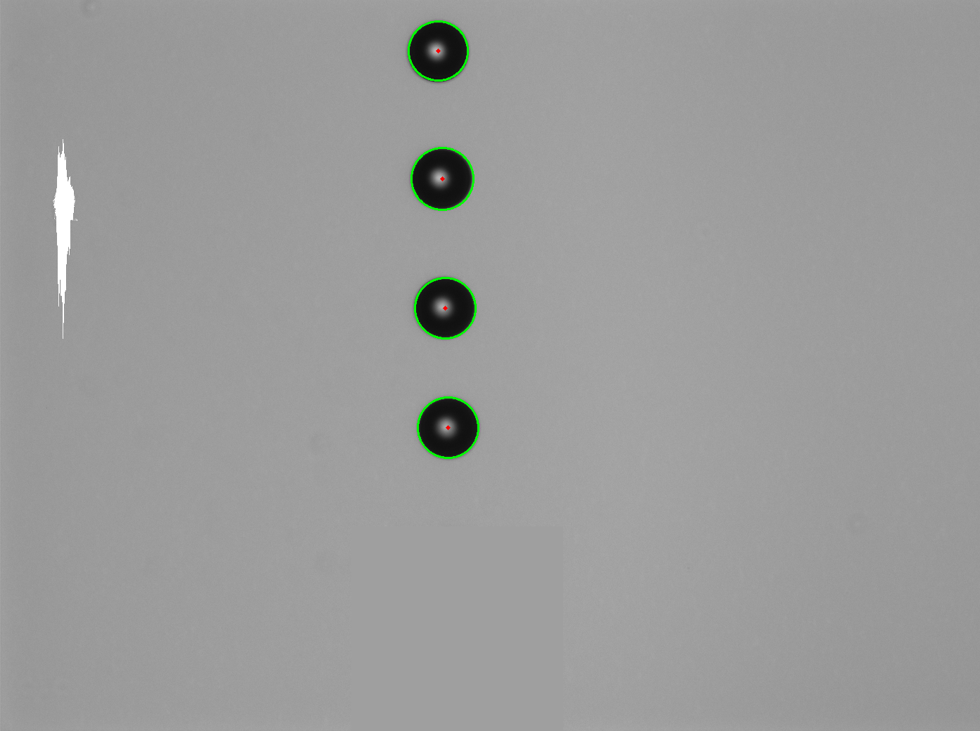
Hough Transform
Classification
Summary of image processing algorithm

Slide 11
Results of Image Processing Algorithm
The algorithm was applied over the entire dataset of 542 images and all the droplets were classified with 100% accuracy.
The entire run took 45 seconds, an average of 0.083 seconds per image. This is significantly faster compared to the system in place in the lab, which takes around 1 minute per raw image, subject to the device being used for processing.
The algorithm gives excellent results for focused images, but the features get complex as the images get blurry. Manually detecting these features and then creating a heuristic for such a large dataset is a tedious task and is much easier done with machine learning, which is adept at learning features of images.

Slide 12
Convolutional Neural Network Models
Convolutional neural networks are a specialized type of artificial neural networks that use a mathematical operation called convolution in place of general matrix multiplication in at least one of their layers.
They are specifically designed to process pixel data and are used in image recognition and processing.
CNN models perform exceptionally well in computer vision tasks such as image classification, object detection, image recognition, and so on.

Slide 13
YOLOv5
YOLO or You Only Look Once is one of the most famous object detection algorithms due to its speed and accuracy.
To test how the data behaves with CNNs, a transfer learning was done from YOLO4v5 pre-trained model on the focused images
The model learned the features very fast and the predictions for the test data were 100% accurate. All the droplets were labelled with their correct diameter classes.
The results of the YOLOv5 confirmed the capability of CNNs to learn the required features from the data.

Slide 14
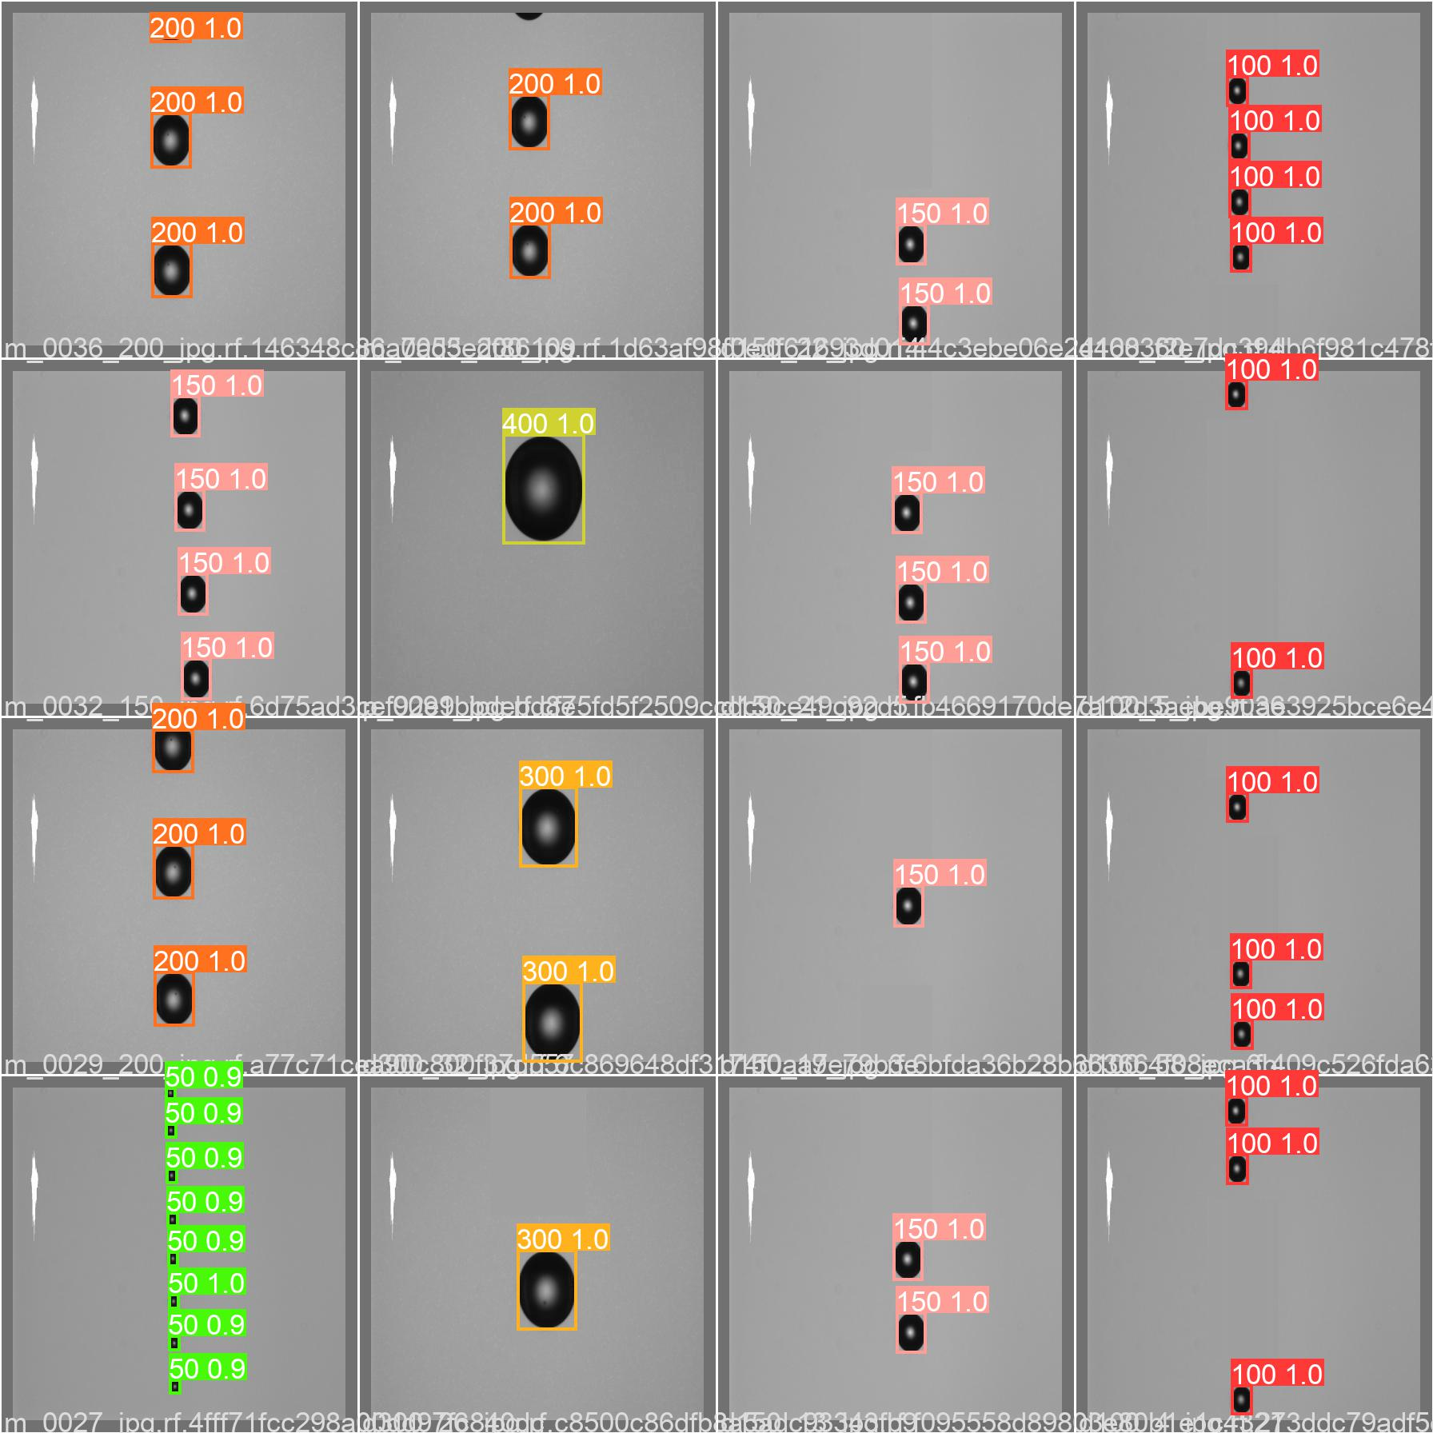
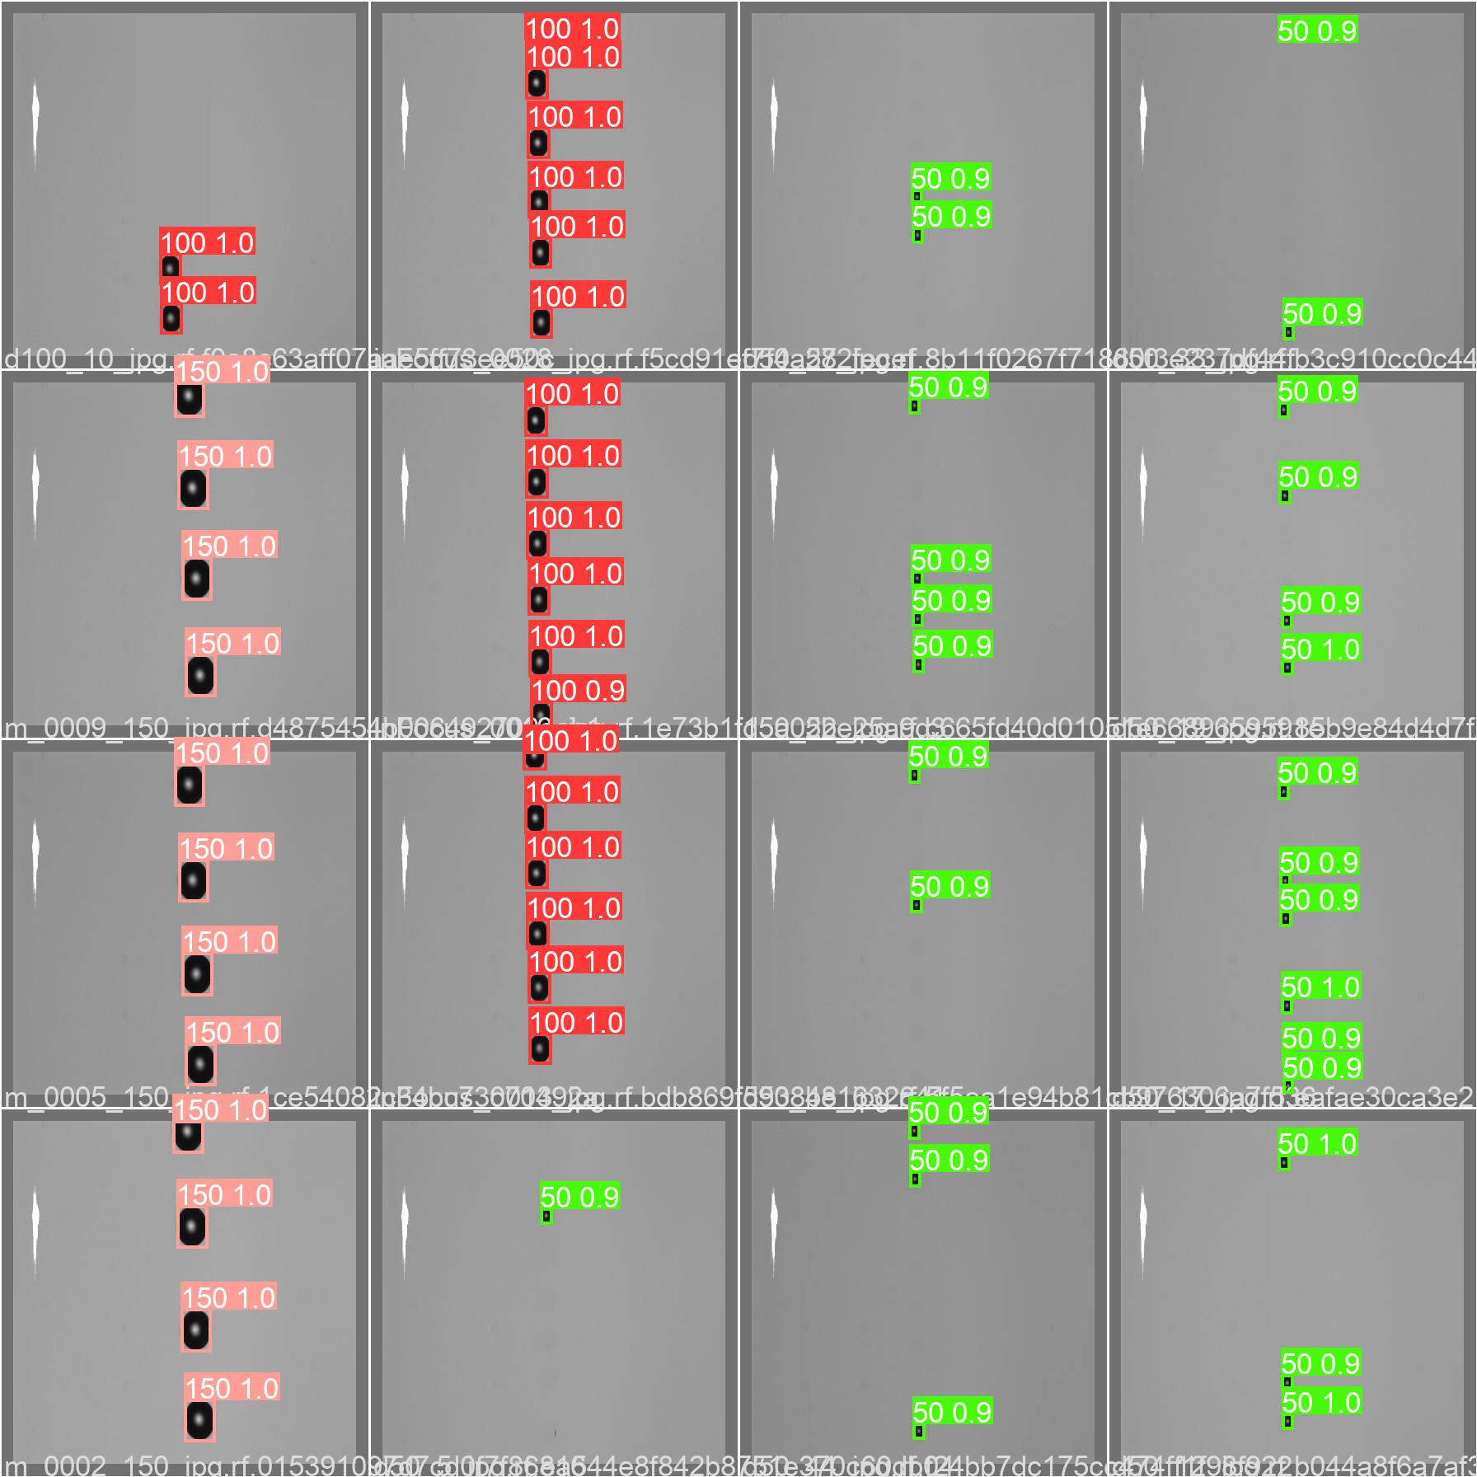
Sample outputs of YOLOv5

Slide 15
Overview of methodology for CNN models
Pre-processing raw image data to create a dataset of individual droplet images with annotation
Testing the model on raw images to check real-time performance
1
3
2
Training and testing the CNN on this data.

Slide 16
Dataset Generation & Pre-Processing
Contours were detected on the raw image using OpenCV
Data was cleaned by removing contours that weren't roughly circular or are too small to be a droplet.
ROIs were pasted on a 512 x 512 pixel background to create uniform-size training images
Annotation file was created for training labels
The dataset was split into training, validation and testing sets with 10% data in both validation and testing sets,
* For bigger training datasets that included 5 or more than 5 different diameters, only droplets that fell in the 300mm range of focal plane on both sides were included in the training

Slide 17
Training the Models
The training was done for 3 different cases on the focused data and 5 different cases on the defocused data, each with varying complexity and dataset.
Focused data Case 1: Droplets of all diameters used for training. Case 2: Droplets of 100 µm were not included in the training and testing was done with these droplets. Case 3: Droplets of 200 µm were not included in the training and testing was done with these droplets. | Defocused data Case 1: Droplets of all diameters used for training. Only position was predicted. Case 2: Droplets of diameters 50 µm, 100 µm, and 150 µm used for training. Both diameter and position were predicted. Case 3: Droplets of all diameters used for training. Both diameter and position were predicted. Case 4: Droplets of 100 µm were not included in the training and testing was done with these droplets. Case 5: Droplets of 200 µm were not included in the training and testing was done with these droplets.

Slide 18
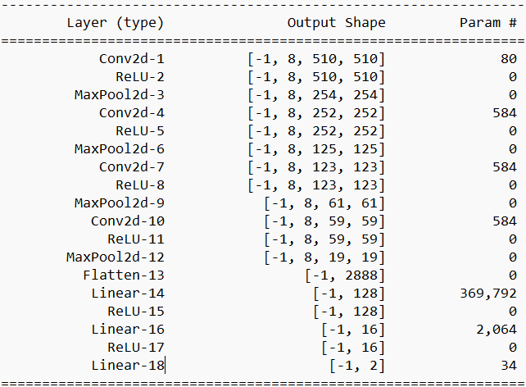
Architecture of CNN model used

Slide 19
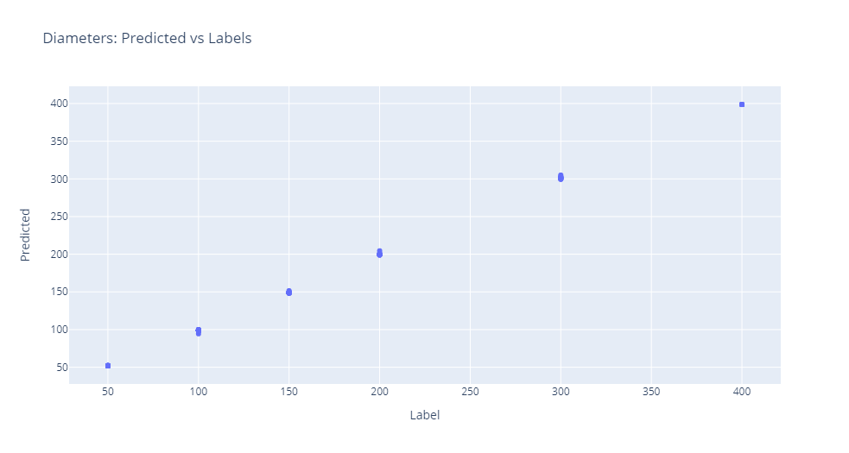
Focused: All Diameters

Slide 20
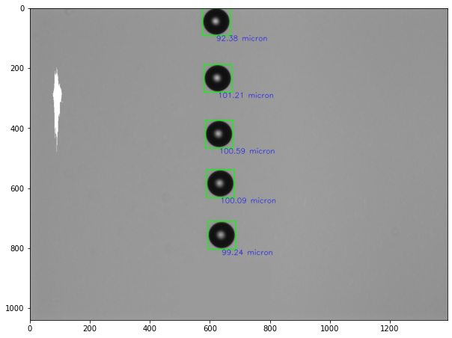
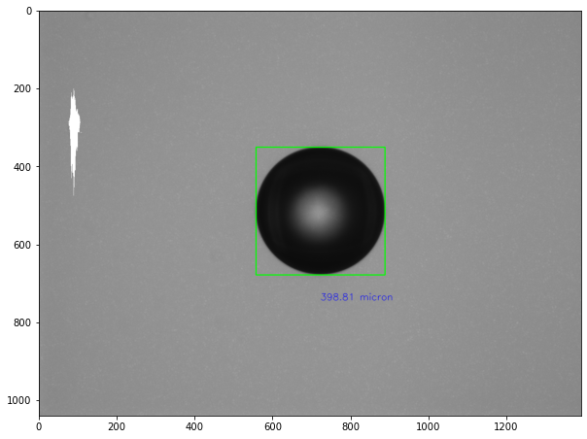
Sample outputs
100 µm
-400 µm

Slide 21
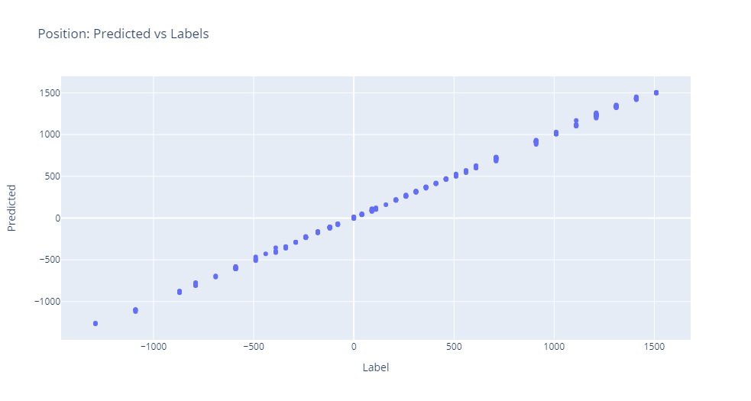
Defocused: Only 100 µm

Slide 22
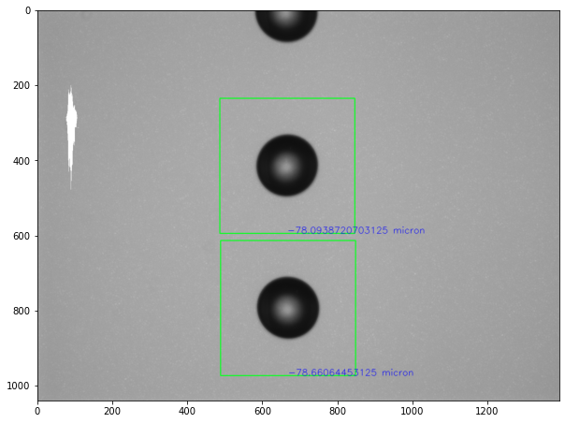
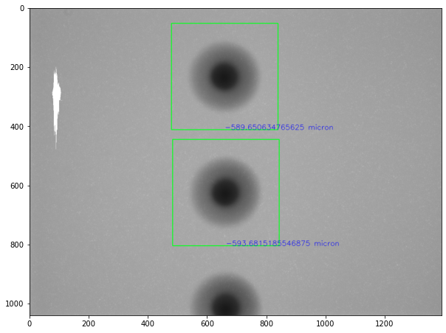
Sample outputs
-80 µm from focus
-600 µm from focus

Slide 23
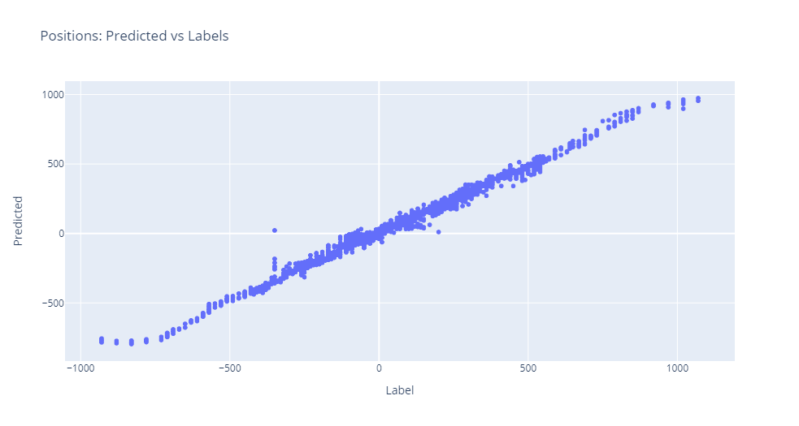
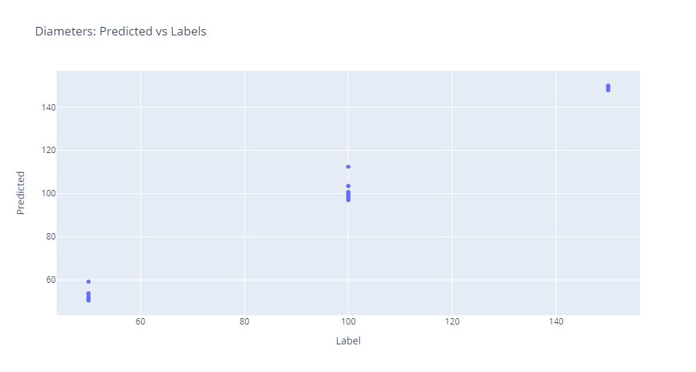
De-focus: 50 µm, 100 µm and 150 µm
Predicted vs Labels for Diameters
Predicted vs Labels for Positions

Slide 24
De-focus: All Diameters, 300 µm range on both sides
This is the model that used maximum data while training. It was able to handle two target variables (diameter and position) and large datasets of 30000+ images
Model is able to distinguish between droplets at the same distance from focus on opposite sides.
While testing, the average time taken by the model to process one raw image was 0.691375 seconds, this is significantly faster compared to the lab system that took around 1 minute per image.
The accuracy values are also better than the results from the current system at lab, where the diameter values were predicted with an error of 5%, compared to the CNN model that has a mere 0.685% mean percentage error, which is an 86.3% improvement in accuracy.

Slide 25
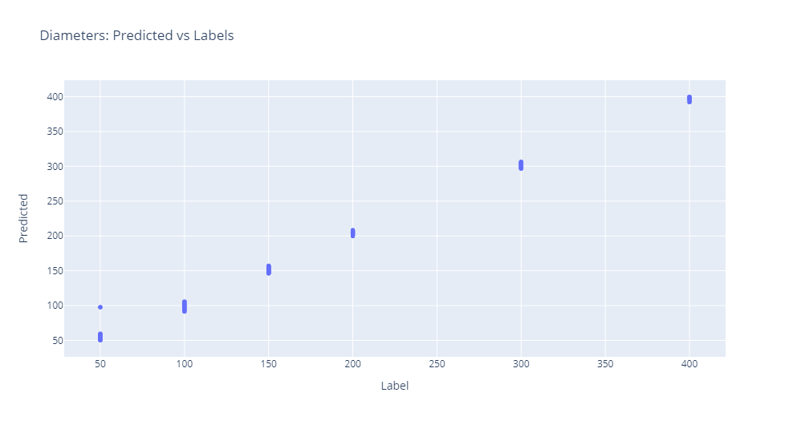
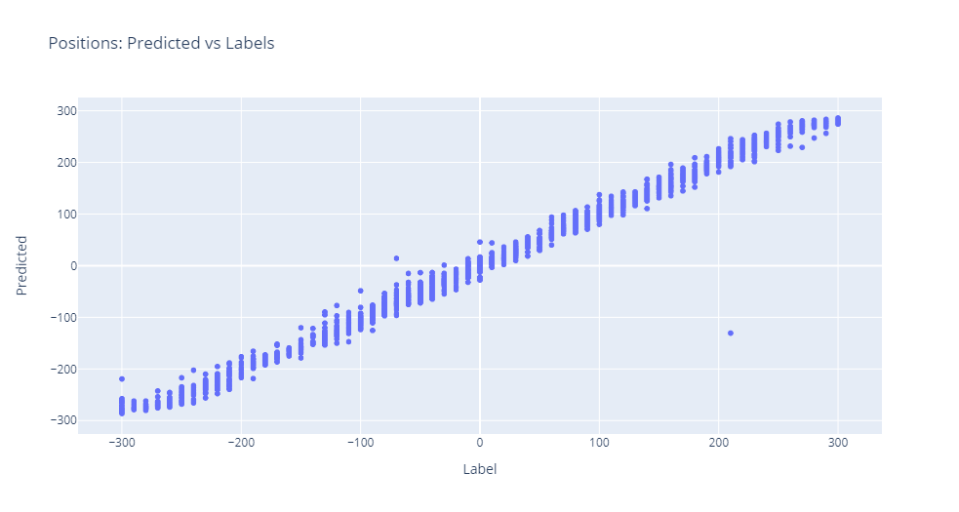

Slide 26
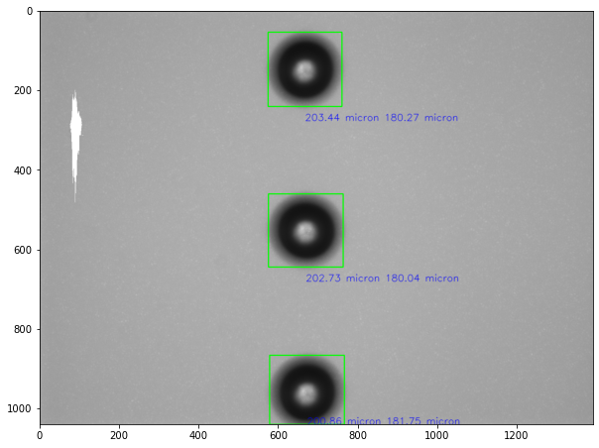
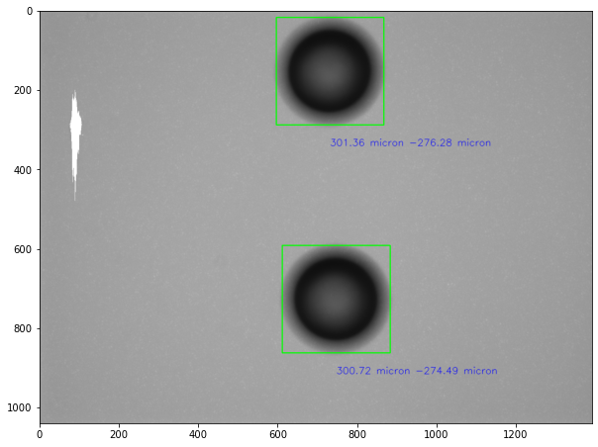
Sample outputs
200 µm diameter, 180 µm from focus
300 µm diameter, -274 µm from focus

Slide 27
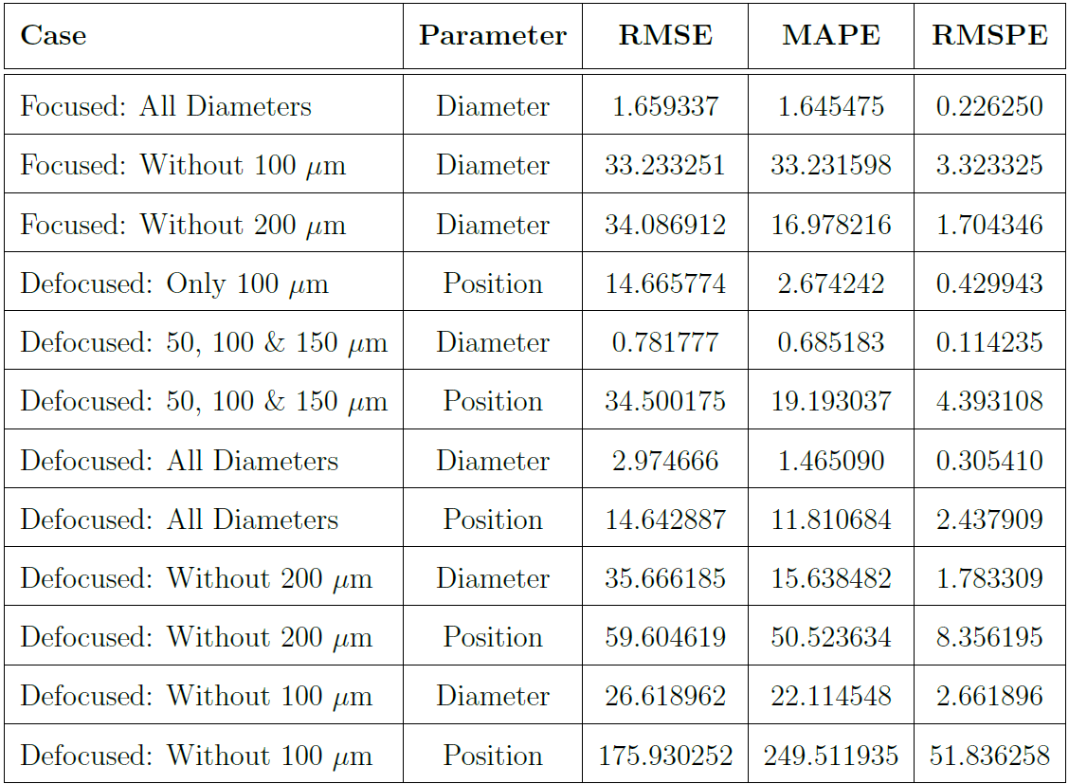
Accuracy Metrics

Slide 28
Real World Capabilities of the Models
The data from the lab consists of only droplets belonging to the six diameter classes.
In the real world, the model may encounter droplets of any size without any prior information regarding the data.
To examine the capabilities of the model to predict intermediate values correctly, training was done after removing a class from the dataset and testing the model with data from the removed class.

Slide 29
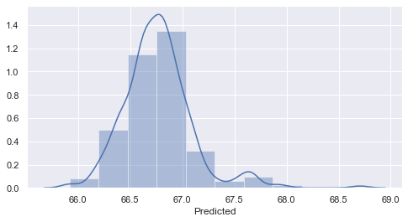
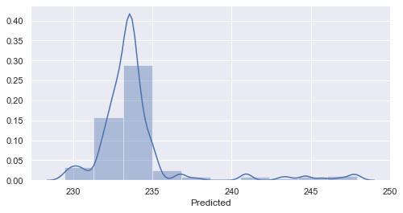
Focused: Without 100 µm and 200 µm
Distribution of predicted diameters of 200 µm droplets
Distribution of predicted diameters of 100 µm droplets

Slide 30
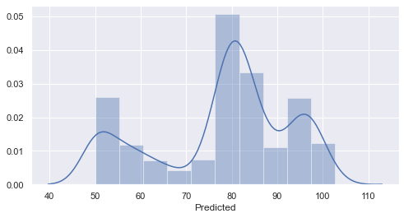
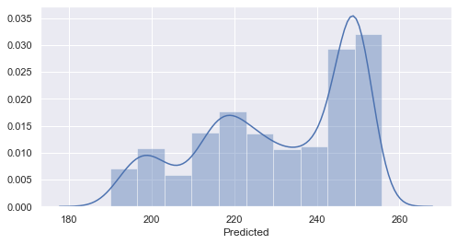
Defocused: Without 100 µm and 200 µm
Distribution of predicted diameters of 200 µm droplets
Distribution of predicted diameters of 100 µm droplets

Slide 31
Limitations & Proposals
If a model that was trained within set range ( [-300, 300] in this case) encounters a droplet outside the range, it will predict a value that falls within its operating range. This is a limitation of the model.
Realistically, it is not possible to train a model that can give an infinite range of outputs. So the only way to tackle this issue is to filter out droplets that fall well outside the range before feeding them into the CNN model.
This can be done bye filtering data that is blurred beyond a point. This requirement also aligns with the requirement to clean the data by removing blurry droplets before processing.

Slide 32
Blurriness Measurement
For each of the diameter classes, the average blurriness values vs distance from the focal plane was plotted.
Average blurriness for an image was calculated by taking the mean of the blurriness values of the individual droplets in the image. The value of blurriness is a measure of how unfocused the image. The higher this value, the more focused the image is..
There is a rise in this value around certain distances. In future work, this feature may be used to filter out droplets that are too out of focus, although the distinction is very subtle in 300 and almost non-existent for 400 diameter droplets.

Slide 33
Summary
The image processing approach based on detecting circular shapes in an image was found to perform very well in the case of focused droplets.
The CNN-based approach also worked very well on the focused droplets, but a machine-learning based approach is unnecessary as the features were very simple to extract.
In case of the defocused data, the CNN model was able to predict the diameter values within 0.685% of the real values, compared to the system at lab which has an error of 5%, which is an 85.3% improvement.
The model also predicted the position values within 20% of the real values, which is a useful advancement in measurement of depth of field.
he model was also found to significantly faster, with each image taking around 0.69s to process on an average, in contrast to the current system in place, which takes around 1 min per image.
To test the real world capabilities of the models, they were tested with intermediate values and it was found that although the predictions were within the expected range, there was much room for improvement of accuracy.

Slide 34
Scope for Future Work
The work proves that CNN models are very capable of learning the features of droplet images.
With a better model, finer tuning and some enhancements in the pre-processing steps, it is possible to significantly improve the ability to predict the size of real world droplets.
It is possible to learn the blurriness features of the images and filter them out, with a combination of image processing and machine learning.
A combination of these two improvements would result in a well-rounded system to calculate the parameters of a droplet from an image.

Slide 35
Thank You

